Slide 1
TIGIS – Tourist Itinerary GIS
Urmil Modi
Edwin Zhang
Fahim Rahman Talukder

Slide 2
Agenda
Future Pitch
Competition
Milestone 3 (M3): A*
Current Design and Achievements
Milestone 4 (M4) Algorithms
Future Design Goals

Slide 3

[F1]

Slide 4
Problem
Tourists must abide by the restrictions of their tour line package instead of freely rescheduling their itinerary.

Slide 5
Finding the Gap in the Market
Who is our target market?
Tourists travelling independently from tourist companies.
What is the best way to help tourists?
Giving tourists the tailored software tools they need for navigation.
How can we ensure tourists have a pleasant experience?
Optimize for responsiveness comparable to other GISs.

Slide 6
The Situation
Tourists find utilizing GISs for itinerary planning enhances their experience [1].

Slide 7
Here’s an Idea!
A GIS that fulfills the needs of the everyday tourist!

Slide 8
Where There’s a Will, There’s a Way!
Allow for more personalized travel plans
Reduce confusion and difficulty in organizing their travel route
Improve the overall quality of their trip!
Notes:
Our GIS will be specialized and optimized for the tourist to:

Slide 9


Who’s our Competition?
[F3]
[F2]
Tourists already utilize more commonly known GISs
Notes:
Strengths: fast responsiveness
Weaknesses: not tailored for the tourist
To compete we must make our GIS EXTREMELY FAST

Slide 10
What Design Goals have we achieved?
Optimized for a high degree of responsiveness
Developed reliable M3 and M4 algorithms for the user
Notes:
We will prove that we have:
THIS IS WHY IT will compete with Google

Slide 11
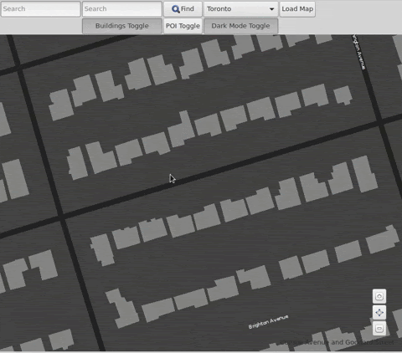
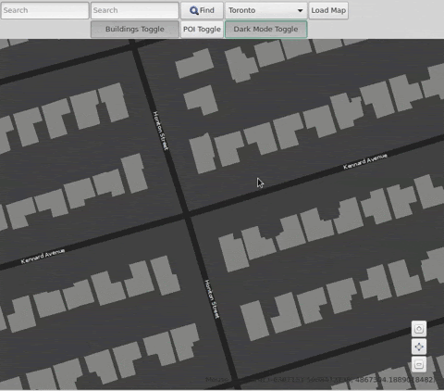
Design Achievements
Standard EZGL GIS
Our Product – TIGIS
Improved map responsiveness by ~100x

Slide 12
Design Achievements
Created fast and perfect A* route calculation
Programmed 3 different working solutions for M4
Christofides/Prims Algo
Ant Colony Optimization (ACO)
Simulated annealing
Place 12th on the M4 leaderboard
Notes:
Make a joke about how we’re group cd012 and we placed 12

Slide 13
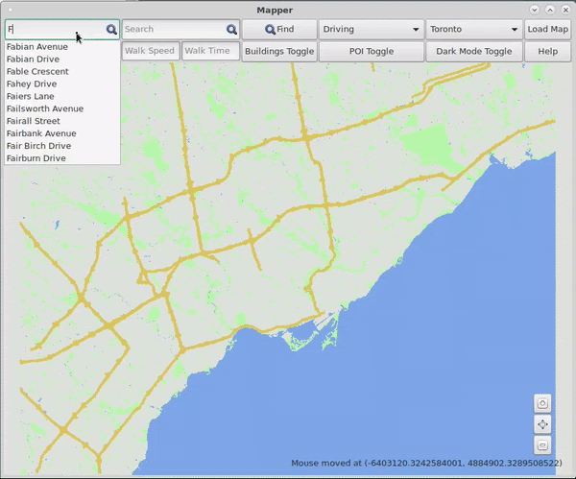
Milestone 3: Our A* Is Efficient
Perfect score on public and private exercisers
Computation times in microseconds
Time Complexity: O(V + ElogV)
Notes:
V – the number of intersections checked
E – the number of street segments checked

Slide 14
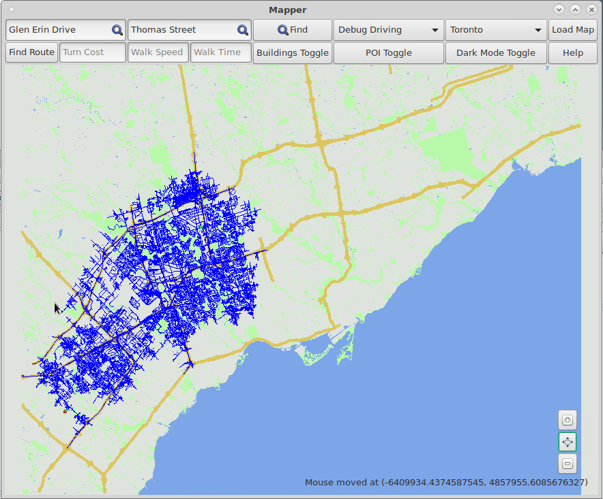
Complete & Optimal Search
Heuristic informed search
Consistent & Admissible Heuristic [2]
Notes:
Consistent Under approximating heuristic accounts for worst case scenarios
Large search areas ensures that the best path is always found

Slide 15
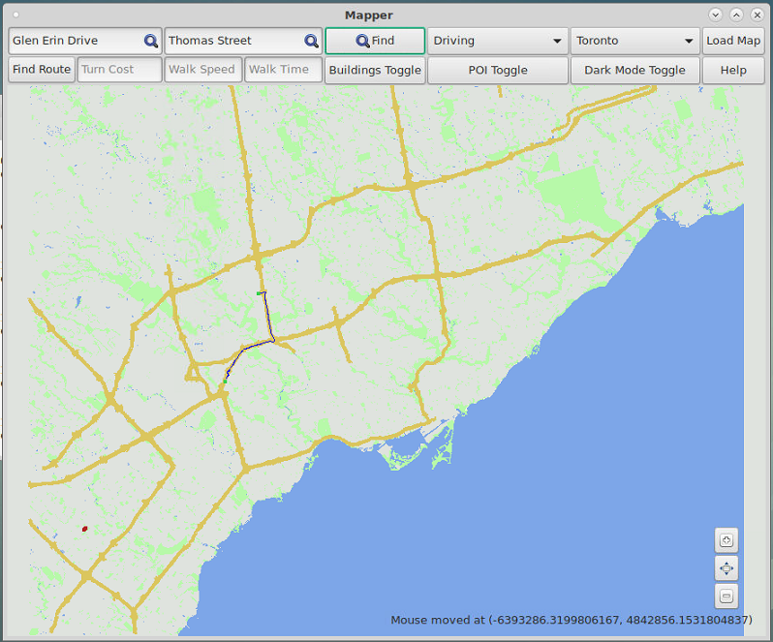
A* Search Heuristic
1 = Precise Travel Time from Start to A
2 = Heuristic Travel Time from A to Destination
Estimated Travel Time to Destination = 1 + 2
Start
A
Destination

Slide 16
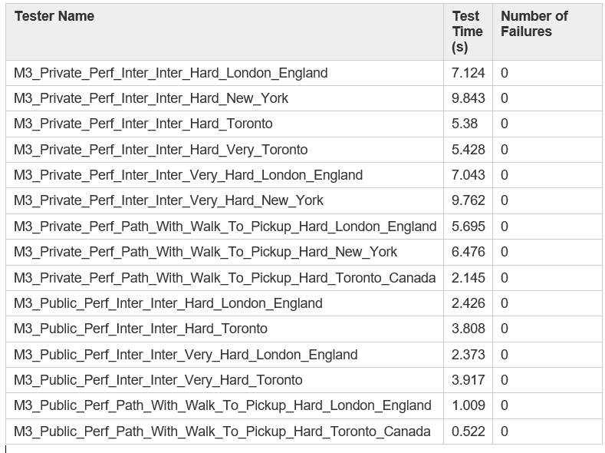













A* Search is Incredibly Responsive
Complete private exerciser in seconds
Result of algorithm implementation using priority queues, and code optimization

Slide 17
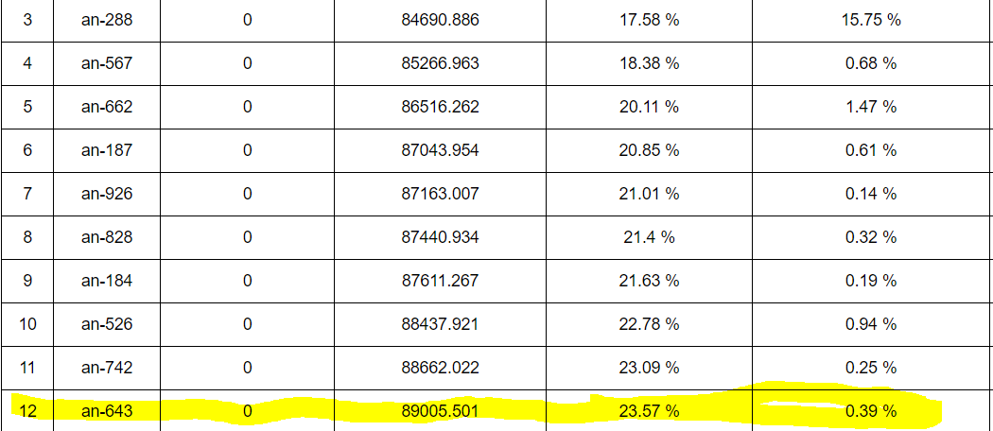

Milestone 4: Algorithms
Find a legal solution (Greedy)
Optimize that solution (Simulated annealing)

Slide 18
An Overview Of Our Greedy Algorithm
Computes the best decision to make at each intersection based on:
Truck capacity
Truck inventory
Time between each intersection
Legal moves
Remaining deliveries
Time Complexity: O(n²)

Slide 19
How Optimal Is Our Greedy Algorithm?
Achieved QOR just under TA Good at 94,000
Computational time less than 3 seconds
Preloaded route data with threaded multistart dijkstra

Slide 20
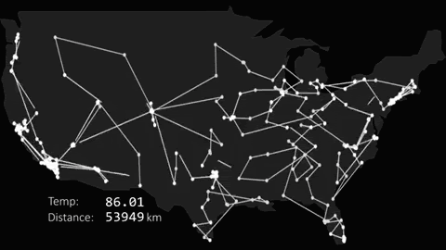
Our Optimization Technique: Simulated Annealing
Based off real life chemical annealing
Accepts worse solutions when lots of time remains
Only accepts better solutions with less time
[F4]
Notes:
Relatively close to the top teams, where the differences between each are very small

Slide 21
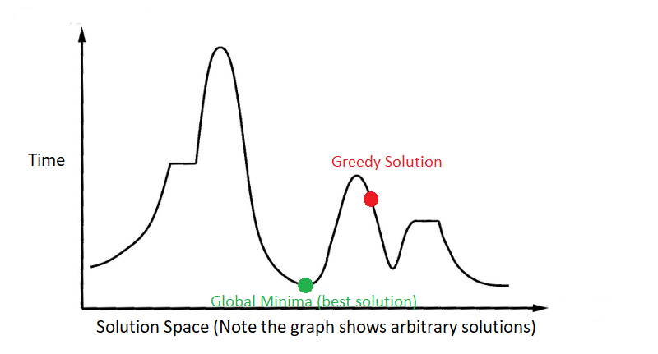
Why Do We Want Worse Solutions?
[F5]

Slide 22
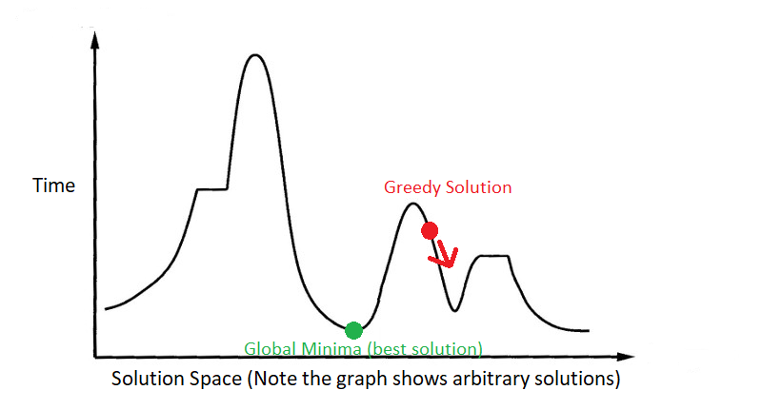
Why if We Only Take Better Solutions?

Slide 23
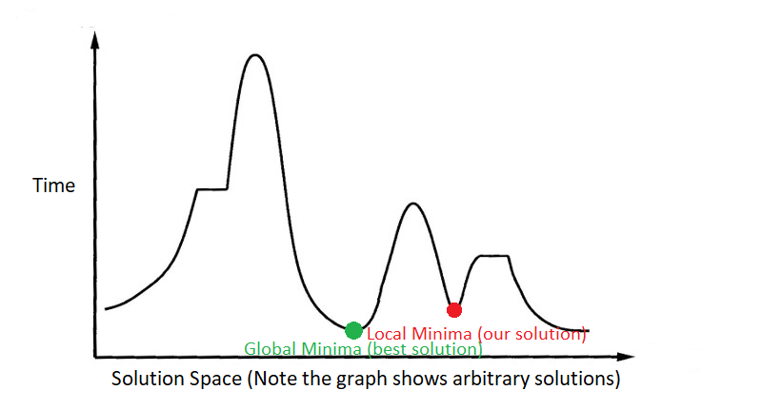
Why if We Only Take Better Solutions?

Slide 24
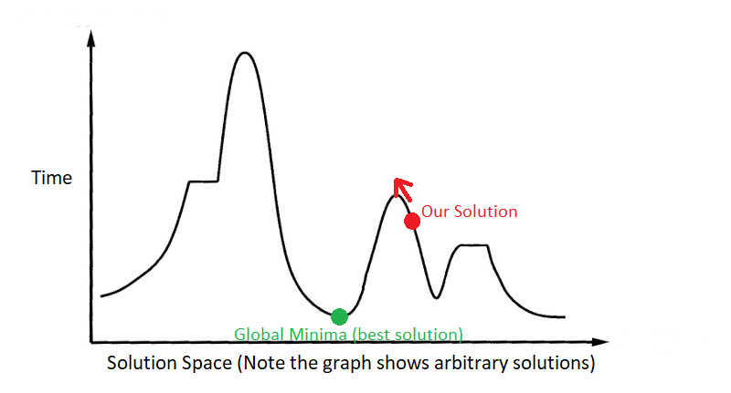
Why Do We Want Worse Solutions?

Slide 25
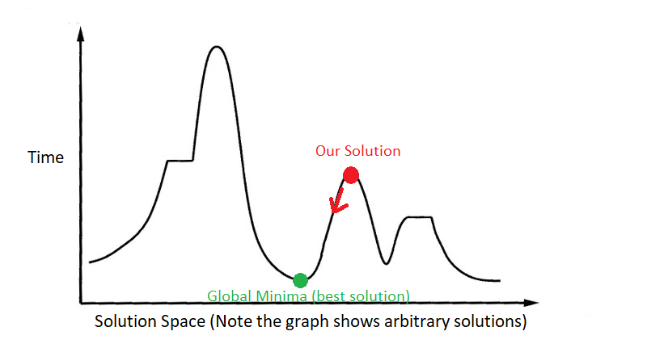
Why Do We Want Worse Solutions?

Slide 26
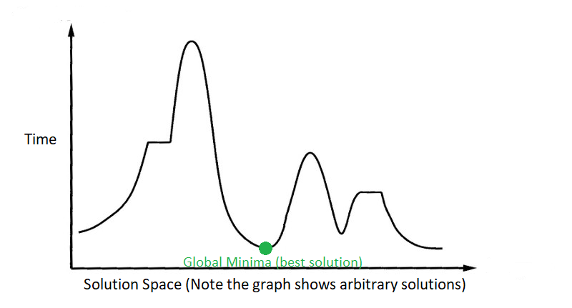
Why Do We Want Worse Solutions?

Slide 27
How Do We Traverse The Graph
Permutation Techniques
2 Opt
Intersection Swap

Slide 28
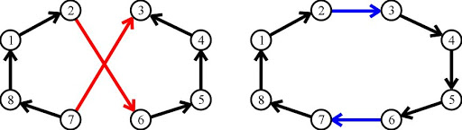
Permutation Operator: 2 Opt
Chooses 2 paths and switches the order
Creates large “mutations” in solutions
Less legal combinations
[F6]

Slide 29
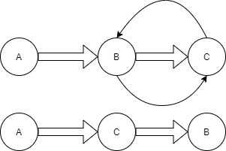
Permutation Operator: Intersection Swap
Chooses 2 intersections and changes the order
Smaller mutations
More legal solutions
[F7]

Slide 30
Our Simulated Annealing Is Iterative

Slide 31
Notice A Problem?
Greedy QOR: 94,000
Final QOR: 89,000
Legal Solutions: 100M to 400M

Slide 32
Why Our Annealing Underperforming?
Could be many reasons:
Did not fine tune heuristics & probability models
2 opt mutation is not large enough to overcome “hills”
Greedy algorithm is too close to local minima

Slide 33
What are our Future Design Goals?
Given another work term, further develop our ACO
Create an AI that can be trained to find optimal routes for tourists
Introduce Web Based Platform
Application Download Available for offline use
Create a perfect travel itinerary for any tourist
OpenStreetMap Database
Private & Public Datasets
Notes:
Our Data will be gathered using the OpenStreetMap Database, and if needed seeking private research or dataset companies, such as kaggle.com
Eliminate Load Time using Servers and provide a download option for tourists who want the option

Slide 34
The Tourism AI Will Account For....
Live data for more accurate routes
Data about tourism points
What time (s) is the destination open?
When are the best times/seasons to visit
Prices
How busy a destination is

Slide 35
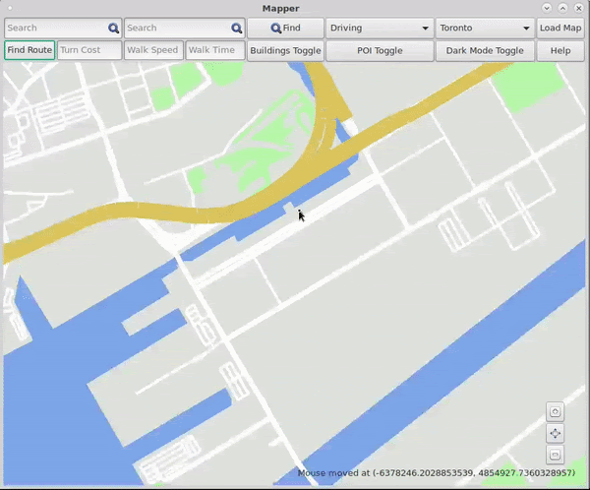
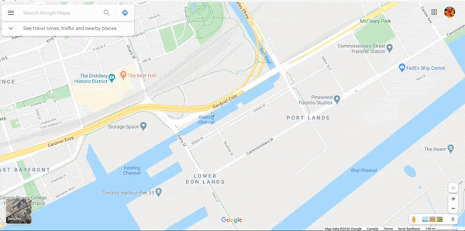
What Competition?
When compared to other GISs, we are comparable in responsiveness

Slide 36
What Have We Learned?
We have identified a gap in the current state of the tourist.
We have realized that current GISs do not tailor to tourists.
We have developed a GIS that is comparable in responsiveness to Google within the span of one semester!
An extra work term will allow us to expand even further to meet the needs of the user!

Slide 37
We are more than capable of delivering our promise for a tourist vacation planner in the form of a GIS!

Slide 38
Source Citations
[1] Cristiane Alcântara de Jesus Santos, Antonio Carlos Campos, and Larissa Prado Rodrigues, “GIS and touristic itineraries. The case of São Cristóvão, Sergipe, Brazil,” Research Gate , May-2019. [Online]. Available: https://www.researchgate.net/publication/333675734_GIS_and_touristic_itineraries_The_case_of_Sao_Cristovao_Sergipe_Brazil. [Accessed: 12-Apr-2020].
[2] “CSci 4511w: Class Notes on Search,” CSci 4511w: Artificial Intelligence. [Online]. Available: https://www-users.cs.umn.edu/~gini/4511/search. [Accessed: 14-Apr-2020].

Slide 39
Image Citations
[F1] “Careers In Hospitality And Tourism,” Resumes - tomope.zaribanks.co. [Online]. Available: http://tomope.zaribanks.co/careers-in-hospitality-and-tourism/. [Accessed: 13-Apr-2020].
[F2] Thurrottfeed/, “Google Maps Turns 15, Gets New Features, Icon,” Thurrott.com, 06-Feb-2020. [Online]. Available: https://www.thurrott.com/google/229530/google-maps-turns-15-gets-new-features-icon. [Accessed: 13-Apr-2020].
[F3] CSA Ocean Sciences, “CSA's EDGS Team Commits to the ArcGIS Pro Transition,” CSA Ocean Sciences. [Online]. Available: https://www.csaocean.com/blog/csa-s-edgs-team-commits-to-the-arcgis-pro-transition. [Accessed: 13-Apr-2020].
[F4] n Sanity, “Travelling Salesman Problem Visualization” Available: www.youtube.com/watch?v=SC5CX8drAtU&fbclid=IwAR0-N0VfcBVN0J_K3Fq27kdqJyY7VJDItucYc8HWN8RiISOw9J5XadfUtaI
[F5] Simulated Annealing Plot [Online]. Available: https://lh3.googleusercontent.com/XapC3gIh1w8dTRAZalFX5ggqIh_g7ZrFOOXGEm8k6DvgfLtlQxFyrvKK-FN9DatWXE0P=s158
[F6] DevX. [Online]. Available: http://www.devx.com/supportitems/showSupportItem.php?co=33574&supportitem=figure3. [Accessed: 14-Apr-2020].
[F7] 2-opt [Online]. Available: https://lh3.googleusercontent.com/niUbRwDExmuoPBNzWVhiW5Njyc-r3zgkVcTCk9ERpVT0ws19IWOvKQ5Bw4AtMJYDz_MIgg=s127
[Any figures without citations are produced by us.]

